Slide 3
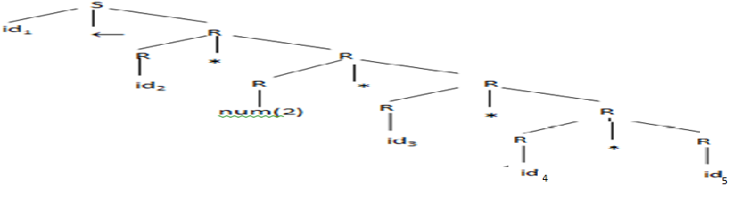
Introduction
Parsing is the second stage of the compiler’s front end.
The parser works with the program as transformed by the scanner; it sees a stream of words where each word is annotated with a syntactic category.
The parser derives a syntactic structure for the program, fitting the words into a grammatical model of the source programming language.
If the parser determines that the input stream is a valid program, it builds a concrete model of the program for use by the later phases of compilation.
If the input stream is not a valid program, the parser reports the problem and appropriate diagnostic information to the user.
a←a * 2 * b * c * d
<id,a><assign, ← > <id,a> <mul,*> <num,2> <mul,*> <id,b> <mul,*> <id,c> <mul,*> <id,d>

Slide 4
Introduction
Parser’s primary responsibility is to recognize syntax—to determine if the program being compiled is a valid sentence in the syntactic model of the programming language.
That model is expressed as a formal grammar G; if some string of words s is in the language defined by G we say that G derives s.
For a stream of words s and a grammar G, the parser tries to build a constructive proof that s can be derived in G—a process called parsing.

Slide 5
Introduction
Parsing algorithms fall into two general categories.
Top-down parsers try to match the input stream against the productions of the grammar by predicting the next word (at each point).
Bottom-up parsers work from low-level detail—the actual sequence of words—and accumulate context until the derivation is apparent.

Slide 7
Expressing Syntax
The task of the parser is to determine whether or not some stream of words fits into the syntax of the parser’s intended source language.
In practice, we need a notation to describe the syntax of languages. In Chapter 2, we worked with one such notation, regular expressions.
They provide a concise notation for describing syntax and
an efficient mechanism for testing the membership of a string in the language described by an RE.
Unfortunately, REs lack the power to describe the full syntax of most programming languages.
For most programming languages, syntax is expressed in the form of a context-free grammar. This section introduces and defines CFGs and explores their use in syntax-checking.

Slide 8
Expressing Syntax
Why Not Regular Expressions?
To motivate the use of CFGs, consider the problem of recognizing algebraic expressions over variables and the operators +, -, × , and ÷.
We can define “variable” as any string that matches the RE [a. . . z] ([a. . . z] | [0. . . 9])* (the lower case version of Algol’s identifier).
We can define an expression as follows
This RE matches “a + b × c” and “fee ÷ fie × foe”.
in “a + b × c,” which operator executes first, the + or the × ? That is not mentioned by this RE.
So we need to add parenthesis in the RE.

Slide 9
Expressing Syntax
Why Not Regular Expressions?
The RE to represent an expression enclosed by parenthesis is below, the expression starts with a ‘(’, and ends with ‘)’.
The above RE, still not have parentheses to denote the operator precedence.
The internal instances of ( all occur before a variable; similarly, the internal instances of ) all occur after a variable. This observation suggests the following RE:
Notice that we simply moved the final ) inside the closure.

Slide 10
Expressing Syntax
Why Not Regular Expressions?
This RE matches both “a + b × c” and “( a + b ) × c.”
It will match any correctly parenthesized expression over variables and the four operators in the RE.
Unfortunately, it also matches many syntactically incorrect expressions,
such as “a + ( b × c” and “a + b ) × c ).”
In fact, we cannot write an RE that will match all expressions with balanced parentheses
This fact is a fundamental limitation of REs;

Slide 11
Expressing Syntax
Context Free Grammars - CFG
To describe programming language syntax, we need a more powerful notation than regular expressions that still leads to efficient recognizers.
The traditional solution is to use a context-free grammar (CFG).
A context-free grammar, G, is a set of rules that describe how to form sentences.
The collection of sentences that can be derived from G is called the language defined by G, denoted G.
The set of languages defined by context free grammars is called the set of context-free languages.

Slide 12
Expressing Syntax
Context Free Grammars - CFG
An Example for CFG
Consider the following grammar, which we call SN:
The first rule, or production reads “SheepNoise can derive the word baa followed by more SheepNoise”
Here SheepNoise is a syntactic variable representing the set of strings that can be derived from the grammar.
We call such a syntactic variable a nonterminal symbol.
Each word in the language defined by the grammar is a terminal symbol.
The second rule reads “SheepNoise can also derive the string baa.”

Slide 13
Expressing Syntax
Context Free Grammars - CFG
An Example for CFG
To understand the relationship between the SN grammar and L(SN), we need to specify how to apply rules in SN to derive sentences in L(SN).
To begin, we must identify the goal symbol or start symbol of SN.
The goal symbol one of the nonterminal symbols, in this example the goal symbol is ‘SheepNoise’.
To derive a sentence in SN, we start with the string that consists of one symbol, SheepNoise.
We can rewrite SheepNoise with either rule 1 or rule 2.
In Table 1, baa is a valid sentence in L(SN).
In Table 2, baa baa, is a sentence in L(SN)
SheepNoise→⁺ baa and SheepNoise→⁺ baa baa.
→⁺ means “derives in one or more steps.”

Slide 14
Expressing Syntax
Context Free Grammars - CFG
An Example for CFG
All valid strings in SN are derived by zero or more applications of rule 1, followed by rule 2.
Applying rule 1 k times followed by rule 2 generates a string with k +1 baas.

Slide 15
Expressing Syntax
Context Free Grammars - CFG
More Complex Examples
Instead, let’s revisit the example that showed the shortcomings of REs: the language of expressions with parentheses.
Beginning with the start symbol, Expr, we can generate two kinds of subterms: parenthesized subterms, with rule 1, or plain subterms, with rule 2.

Slide 16
Expressing Syntax
Context Free Grammars - CFG
More Complex Examples
To generate the sentence “(a + b) × c”, we can use the following rewrite sequence (2,6,1,2,4,3),
This derivation of (a + b) × c rewrites, at each step, the rightmost remaining nonterminal symbol.
This simple CFG for expressions cannot generate a sentence with unbalanced or improperly nested parentheses.
Only rule 1 can generate an open parenthesis; it also generates the matching close parenthesis.
Thus, it cannot generate strings such as “a + ( b × c” or “a + b ) × c),” and a parser built from the grammar will not accept the such strings.
Clearly, CFGs provide us with the ability to specify constructs that res do not.

Slide 17
Expressing Syntax
Context Free Grammars - CFG
More Complex Examples
The leftmost derivation of (a + b) × c
The leftmost and rightmost derivations use the same set of rules; they apply those rules in a different order.
The parse trees for the two derivations are identical.
From the compiler’s perspective, it is important that each sentence in the language defined by a CFG has a unique rightmost (or leftmost) derivation.
A grammar in which multiple rightmost (or leftmost) derivations exist for a sentence is called an ambiguous grammar.

Slide 18
Expressing Syntax
Context Free Grammars - CFG
More Complex Examples
The classic example of an ambiguous construct - grammar for if-then-else
This fragment shows that the else is optional.
The following code fragment has two distinct rightmost derivations.

Slide 19
Expressing Syntax
Context Free Grammars - CFG
More Complex Examples
The difference between them is simple.
The first derivation has Assignment2 controlled by the inner if, so Assignment2 executes when Expr1 is true and Expr2 is false:
(2) The second derivation associates the else clause with the first if, so that Assignment2 executes when Expr1 is false, independent of the value of Expr2:
Clearly, these two derivations produce different behaviors in the compiled code.

Slide 20
Expressing Syntax
Context Free Grammars - CFG
More Complex Examples
To remove this ambiguity, the grammar must be modified to encode a rule that determines which if controls an else. To modified grammar is in R.H.S above.
The solution restricts the set of statements that can occur in the then part of an if-then-else construct
It ensures that else has an unambiguous match to a specific if.
Now it has only one right most derivation for
The rewritten grammar eliminates the ambiguity.

Slide 22
Expressing Syntax
Encoding Meaning into Structure
The if-then-else ambiguity points out the relationship between meaning and grammatical structure.
However, ambiguity is not the only situation where meaning and grammatical structure interact.
Consider the parse tree that would be built from a rightmost derivation of the simple expression a + b x c.
Natural way to evaluate the expression is by postorder tree walk….first compute a + b and then multiply that result by c . ..ie., (a + b) x c.
But, by operator precedence rule it should be a +(b x c).
So, we need to encode operator precedence levels into the grammar.

Slide 23
Expressing Syntax
Encoding Meaning into Structure
This shows the resulting grammar; it includes a unique start symbol, Goal, and a production for the terminal symbols num and name.
First, we must decide how many levels of precedence are required.
In the simple expression grammar, we have three levels of precedence:
(1) highest precedence for ( ),
(2) medium precedence for x and ÷, and
(3) lowest precedence for + and -.
Next, we group the operators at distinct levels and use a nonterminal to isolate the corresponding part of the grammar.
Expr, represents the level for + and -;
Term represents the level for × and ÷, and
Factor represents the level for ( ).

Slide 24
Expressing Syntax
Encoding Meaning into Structure
In this form, the grammar derives a parse tree for a + b x c that is consistent with standard algebraic precedence, as shown below.
Previous derivation
A postorder treewalk over this parse tree will first evaluate b x c and then add the result to a.
Example.

Slide 25
Expressing Syntax
Discovering derivation for an input string
We have seen how to use a CFG G as a rewriting system to generate sentences that are in L(G).
In contrast, a compiler must infer a derivation for a given input string, or determine that no such derivation exists.
The process of constructing a derivation from a specific input sentence is called parsing.
The parser sees the program as it emerges from the scanner: a stream of words annotated with their syntactic categories.
Thus, the parser would see a + b X c as <name, a> + <name, b> X <name, c>
The parser is building a syntax tree for the input program.
The parse tree’s root is known; it represents the grammar’s start symbol.
The leaves of the parse tree are the stream of words.
The hard part of parsing lies in discovering the grammatical connection between the leaves and the root.

Slide 26
Expressing Syntax
Discovering derivation for an input string
Two distinct and opposite approaches for constructing the tree suggest themselves:
Top-down parsers begin with the root and grow the tree toward the leaves.
Bottom-up parsers begin with the leaves and grow the tree toward the root.
In either scenario, the parser makes a series of choices about which productions to apply.
Most of the intellectual complexity in parsing lies in the mechanisms for making these choices.

Slide 28
TOP-DOWN PARSING
A top-down parser begins with the root of the parse tree and systematically extends the tree downward until its leaves match the classified words returned by the scanner.
At each point, the process considers a partially built parse tree.
It selects a nonterminal symbol on the lower fringe of the tree and extends it by adding children that correspond to the right-hand side of some production for that nonterminal.
This process continues until either
the fringe of the parse tree contains only terminal symbols, and the input stream has been exhausted, or
b. a clear mismatch occurs between the fringe of the partially built parse tree and the input stream.

Slide 29
TOP-DOWN PARSING
This process continues until either
the fringe of the parse tree contains only terminal symbols, and the input stream has been exhausted.
In this case the parse succeeds
(or)
b. a clear mismatch occurs between the fringe of the partially built parse tree and the input stream.
a. in this case there are two possibilities
(1) the parser would have chosen wrong production in previous step, so it need to backtrack and check… and construct a new parse tree…
(2) the input string may be invalid.. So backtrack will fail.
One key insight makes top-down parsing efficient is “a large subset of the context-free grammars can be parsed without backtracking”
Will discuss two distinct techniques for constructing top-down parsers: (1) hand-coded recursive-descent parsers and (2) generated LL(1) parsers.

Slide 30
TOP-DOWN PARSING
This is a concrete algorithm for a top-down parser that constructs a leftmost derivation.
It builds a parse tree, anchored at the variable root.
It uses a stack, with access functions push( ) and pop( ), to track the unmatched portion of the fringe.
The main portion of the parser consists of a loop that focuses on the leftmost unmatched symbol on the partially-built parse tree’s lower fringe.
If the focus symbol is a nonterminal, it expands the parse tree downward;
If the focus symbol is a terminal, it compares the focus against the next word in the input.
A match moves both the focus to the next symbol on the fringe and advances the input stream.

Slide 31
TOP-DOWN PARSING
If the focus is a terminal symbol that does not match the input, the parser must backtrack.
First, it systematically considers alternatives for the most recently chosen rule.
If it exhausts those alternatives, it moves back up the parse tree and reconsiders choices at a higher level in the parse tree.
If this process fails to match the input, the parser reports a syntax error.
“Backtracking increases the asymptotic cost of parsing; in practice, it is an expensive way to discover syntax errors.”

Slide 32
TOP-DOWN PARSING
Transforming a Grammar for Top-Down Parsing
The efficiency of a top-down parser depends critically on its ability to pick the correct production each time that it expands a nonterminal.
If the parser always makes the right choice, top-down parsing is efficient.
If it makes poor choices, the cost of parsing rises.
For some grammars, the worst case behavior is that the parser does not terminate.
This section examines two structural issues with CFG that lead to problems with top-down parsers and presents transformations that the compiler writer can apply to the grammar to avoid these problems.

Slide 33
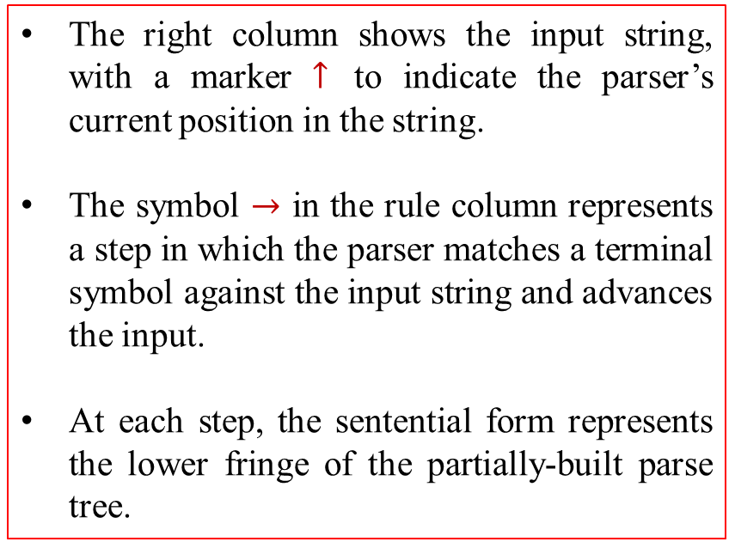
TOP-DOWN PARSING
Transforming a Grammar for Top-Down Parsing
A Top-Down Parser with Oracular Choice
As an initial exercise, consider the behavior of the top-down parser with the grammar in the R.H.S for the string a + b x c.
For the moment, assume that the parser has oracle that picks the correct production at each point in the parse.
With oracular choices, it might proceed as shown in Figure 3.3
The right column shows the input string, with a marker $↑$ to indicate the parser’s current position in the string.
The symbol $→$ in the rule column represents a step in which the parser matches a terminal symbol against the input string and advances the input.
At each step, the sentential form represents the lower fringe of the partially-built parse tree.
a + b x c

Slide 34
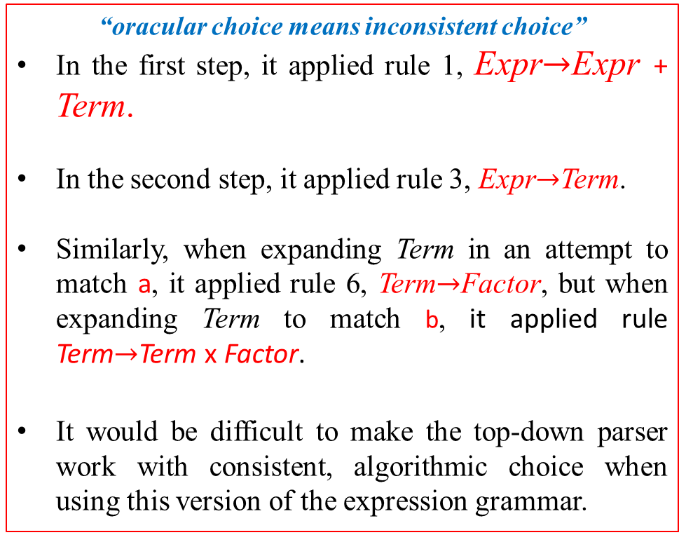
TOP-DOWN PARSING
Transforming a Grammar for Top-Down Parsing
A Top-Down Parser with Oracular Choice
With oracular choice, the parser should take a number of steps proportional to the length of the derivation plus the length of the input.
For a + b x c the parser applied eight rules and matched five words.
“oracular choice means inconsistent choice”
In the first step, it applied rule 1, Expr$→$Expr + Term.
In the second step, it applied rule 3, Expr$→$Term.
Similarly, when expanding Term in an attempt to match a, it applied rule 6, Term$→$Factor, but when expanding Term to match b, it applied rule Term$→$Term x Factor.
It would be difficult to make the top-down parser work with consistent, algorithmic choice when using this version of the expression grammar.
a + b x c

Slide 35
TOP-DOWN PARSING
Transforming a Grammar for Top-Down Parsing
Eliminating Left Recursion
One problem with the combination of the classic expression grammar and a leftmost, top-down parser arises from the structure of the grammar.
To see the difficulty, consider an implementation that always tries to apply the rules in the order in which they appear in the grammar.
Its first several actions would be:
It starts with Expr and tries to match a.
It applies rule 1 to create the sentential form Expr + Term on the fringe.
Now, it faces the nonterminal Expr and the input word a, again.
By consistent choice, it applies rule 1 to replace Expr with Expr + Term.
With this grammar and consistent choice, the parser will continue to expand the fringe indefinitely because that expansion never generates a leading terminal symbol.

Slide 36
TOP-DOWN PARSING
Transforming a Grammar for Top-Down Parsing
Eliminating Left Recursion
This problem arises because the grammar uses left recursion in productions 1, 2, 4, and 5.
With left-recursion, a top-down parser can loop indefinitely without generating a leading terminal symbol that the parser can match (and advance the input).
Fortunately, we can reformulate a left-recursive grammar so that it uses right recursion—any recursion involves the rightmost symbol in a rule.

Slide 37
TOP-DOWN PARSING
Transforming a Grammar for Top-Down Parsing
Eliminating Left Recursion
The translation from left recursion to right recursion is mechanical.
For direct left recursion, like the one shown below to the left, we can rewrite the individual productions to use right recursion, shown on the right.
The transformation introduces a new nonterminal, Fee¹, and transfers the recursion onto Fee¹.
It also adds the rule Fee¹→ ε, where ε represents the empty string.
This ε -production requires careful interpretation in the parsing algorithm.
To expand the production Fee¹→ ε, the parser simply sets focus pop( ), which advances its attention to the next node, terminal or nonterminal, on the fringe.

Slide 38
TOP-DOWN PARSING
Transforming a Grammar for Top-Down Parsing
Eliminating Left Recursion
In the classic expression grammar, direct left recursion appears in the productions for both Expr and Term.
The left-recursive variant of the expression grammar
The right-recursive variant of the expression grammar
Plugging these replacements back into the classic expression grammar yields a right-recursive variant of the grammar, shown in RHS.
This grammar eliminates the problem with nontermination. But it does not avoid backtracking.

Slide 39
TOP-DOWN PARSING
Transforming a Grammar for Top-Down Parsing
Eliminating Left Recursion
Figure shows the behavior of the top-down parser with the right-recursion grammar on the input a + b x c.
The example still assumes oracular choice; we will address that issue in the next subsection.
It matches all 5 terminals and applies 11 productions—3 more than it did with the left-recursive grammar.
All of the additional rule applications involve productions that derive .

Slide 40
TOP-DOWN PARSING
Transforming a Grammar for Top-Down Parsing
Eliminating Left Recursion
“Leftmost Top-Down parsing with the left-recursive expression grammar”
“Leftmost Top-Down parsing with the Right-recursive expression grammar”

Slide 41
TOP-DOWN PARSING
Transforming a Grammar for Top-Down Parsing
Eliminating Left Recursion
We must also eliminate indirect left recursion, which occurs when a chain of rules such as
Such indirect left recursion is not always obvious; it can be obscured by a long chain of productions.
To convert indirect left recursion into right recursion, we need a more systematic approach.
This algorithm eliminates all left recursion from a grammar by thorough application of two techniques:
forward substitution to convert indirect left recursion into direct left recursion and
rewriting direct left recursion as right recursion.
It assumes that the original grammar has no
cycles (A→⁺A) and no -productions.

Slide 42
TOP-DOWN PARSING
Transforming a Grammar for Top-Down Parsing
Backtrack-Free Parsing
The major source of inefficiency in the leftmost, top-down parser arises from its need to backtrack.
If the parser expands the lower fringe with the wrong production, it eventually encounters a mismatch between that fringe and the parse tree’s leaves, which correspond to the words returned by the scanner.
When the parser discovers the mismatch, it must undo the actions that built the wrong fringe and try other productions.
The act of expanding, retracting, and re-expanding the fringe wastes time and effort.
The parser can avoid backtracking with a simple modification.
When the parser goes to select the next rule, it can consider both the focus symbol and the next input symbol, called the lookahead symbol.
We say that the grammar is backtrack free with a lookahead of one symbol.
A backtrack-free grammar is also called a predictive grammar.

Slide 43
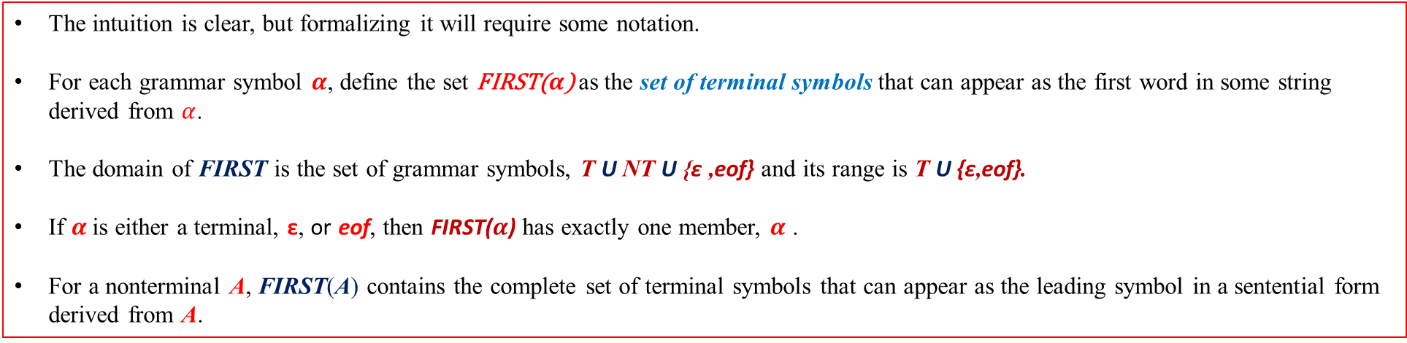
TOP-DOWN PARSING
Transforming a Grammar for Top-Down Parsing
Backtrack-Free Parsing
We can formalize the predictive grammar property that makes the right-recursive expression grammar backtrack free.
At each point in the parse, the choice of an expansion is obvious because each alternative for the leftmost nonterminal leads to a distinct terminal symbol.
Comparing the next word in the input stream against those choices reveals the correct expansion.
The intuition is clear, but formalizing it will require some notation.
For each grammar symbol $α$, define the set FIRST($α$) as the set of terminal symbols that can appear as the first word in some string derived from $α$.
The domain of FIRST is the set of grammar symbols, T U NT U {ε ,eof} and its range is T U {ε,eof}.
If $α$ is either a terminal, ε, or eof, then FIRST($α$) has exactly one member, $α$ .
For a nonterminal A, FIRST(A) contains the complete set of terminal symbols that can appear as the leading symbol in a sentential form derived from A.

Slide 44
TOP-DOWN PARSING
Transforming a Grammar for Top-Down Parsing
Backtrack-Free Parsing
This is the algorithm that computes the first sets for each symbol in a grammar.
As its initial step, the algorithm sets the first sets for the simple cases, terminals, ε, and eof.
For the right-recursive expression grammar shown in Figure 3.4 on page 101, that initial step produces the following first sets:

Slide 45
TOP-DOWN PARSING
Transforming a Grammar for Top-Down Parsing
Backtrack-Free Parsing
Next, the algorithm iterates over the productions, using the first sets for the right-hand side of a production to derive the first set for the nonterminal on its left-hand side.
This process halts when it reaches a fixed point.
For the right-recursive expression grammar, the first sets of the nonterminals are:

Slide 46
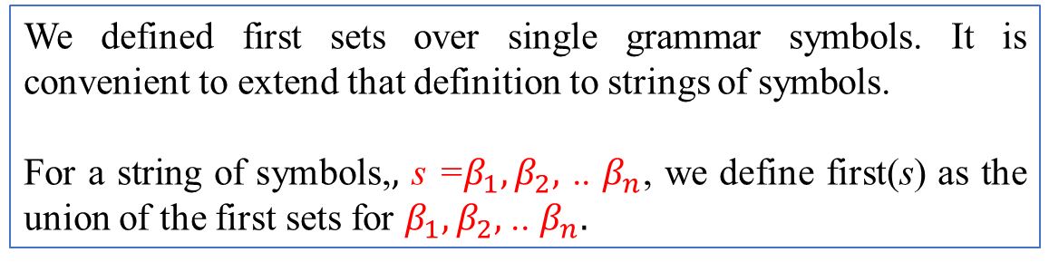
TOP-DOWN PARSING
Transforming a Grammar for Top-Down Parsing
Backtrack-Free Parsing
We defined first sets over single grammar symbols. It is convenient to extend that definition to strings of symbols.
For a string of symbols,$,$ s =$β_{1},β_{2},$ .. $β_{n}$, we define first(s) as the union of the first sets for $β_{1},β_{2},$ .. $β_{n}.$
Conceptually, FIRST sets simplify implementation of a top-down parser.
Consider, for example, the rules for Expr¹ in the right-recursive expression grammar:
When the parser tries to expand an Expr¹, it uses the lookahead symbol and the FIRST sets to choose between rules 2, 3, and 4.
If the lookahead symbol is ‘+’, it uses rule 2.
If the lookahead symbol is ‘-’, it uses rule 3.

Slide 47
TOP-DOWN PARSING
Transforming a Grammar for Top-Down Parsing
Backtrack-Free Parsing
Rule 4, the ε -production, poses a slightly harder problem.
FIRST(ε) is just {ε}, which matches no word returned by the scanner.
Intuitively, the parser should apply the ε-production when the lookahead symbol is not a member of the first set of any other alternative.
To differentiate between legal inputs and syntax errors, the parser needs to know which words can appear as the leading symbol after a valid application of rule 4—the set of symbols that
can follow an Expr¹.
Conceptually, first sets simplify implementation of a top-down parser.
Consider, for example, the rules for Expr¹ in the right-recursive expression grammar:
When the parser tries to expand an Expr¹, it uses the lookahead symbol and the first sets to choose between rules 2, 3, and 4.
If the lookahead symbol is ‘+’, it uses rule 2.
If the lookahead symbol is ‘-’, it uses rule 3.
we define the set FOLLOW(Expr¹) to contain all of the words that can occur to the immediate right of a string derived from Expr¹.

Slide 48
TOP-DOWN PARSING
Transforming a Grammar for Top-Down Parsing
Backtrack-Free Parsing
This is the algorithm to compute the FOLLOW set for each nonterminal in a grammar; it assumes the existence of first sets.
The algorithm initializes each FOLLOW set to the empty set and then iterates over the productions, computing the contribution of the partial suffixes to the FOLLOW set of each symbol in each right-hand side.
The algorithm halts when it reaches a fixed point.
For the right-recursive expression grammar, the algorithm produces:

Slide 49
TOP-DOWN PARSING
Transforming a Grammar for Top-Down Parsing
Backtrack-Free Parsing
The parser can use FOLLOW(Expr¹) when it tries to expand an Expr¹.
If the lookahead symbol is +, it applies rule 2.
If the lookahead symbol is -, it applies rule 3.
If the lookahead symbol is in FOLLOW(Expr¹), which contains eof and ), it applies rule 4.
Any other symbol causes a syntax error.

Slide 50
TOP-DOWN PARSING
Transforming a Grammar for Top-Down Parsing
Another procedure for FIRST(X)
If X is Grammar Symbol, then First (X) will be
If X is a terminal symbol, then FIRST(X) = {X}
If X → ε, then FIRST(X) = {ε}
If X is non-terminal & X → a α, then FIRST (X) = {a}
If X → Y₁, Y₂, Y₃, then FIRST (X) will be
(4.a) If Y1 is terminal, then
FIRST (X) = {Y₁}
(4.b) If Y₁ is Non-terminal and
If FIRST (Y₁) does not contain ε then, FIRST (X) = FIRST(Y₁)
(4.c) If FIRST (Y₁) contains ε, then.
FIRST (X) = FIRST(Y₁) − {ε} ∪ FIRST(Y₂, Y₃)
Similarly, FIRST (Y₂, Y₃) = {Y₂}, If Y₂ is terminal otherwise
if Y₂ is Non-terminal then
FIRST (Y₂, Y₃) = FIRST (Y₂), if FIRST (Y₂) does not contain ε.
If FIRST (Y₂) contain ε, then
FIRST (Y₂, Y₃) = FIRST (Y₂) − {ε} ∪ FIRST (Y₃)
Similarly, this method will be repeated for further Grammar symbols, i.e., for Y₄, Y₅, Y₆ … . Y_{K}.
FIRST (α) is defined as the collection of terminal symbols which are the first letters of strings derived from α.
FIRST (α) = {α |α →∗ αβ for some string β }

Slide 51
TOP-DOWN PARSING
Transforming a Grammar for Top-Down Parsing
Another procedure for FOLLOW
Follow (A) is defined as the collection of terminal symbols that occur directly to the right of A.
FOLLOW(A) = {a|S ⇒* αAaβ where α, β can be any strings}
Rules to find FOLLOW
(1) If S is the start symbol, FOLLOW (S) ={$}
(2) If production is of form A → α B β, β ≠ ε.
(2.a) If FIRST (β) does not contain ε then, FOLLOW (B) = {FIRST (β)}
Or
(2.b) If FIRST (β) contains ε (i. e. , β ⇒* ε), then
FOLLOW (B) = FIRST (β) − {ε} ∪ FOLLOW (A)
∵ when β derives ε, then terminal after A will follow B.
(3) If production is of form A → αB, then Follow (B) ={FOLLOW (A)}.

Slide 52
TOP-DOWN PARSING
Transforming a Grammar for Top-Down Parsing
Backtrack-Free Parsing

Slide 53
TOP-DOWN PARSING
Transforming a Grammar for Top-Down Parsing
Backtrack-Free Parsing
Left-Factoring to Eliminate Backtracking
Not all grammars are backtrack free.
Example, consider extending the expression grammar to include
function calls, denoted with parentheses, ( and ), and
array-element references, denoted with square brackets, [ and ].
To add these options, we replace production 11, Factor→ name, with a set of three rules, plus a set of right-recursive rules for argument lists.
To expand Factor with a lookahead of name,
there is no basis to choose among 11, 12, and 13.
Rewriting of productions 11, 12, and 13, to be done.
* This transformation is left factoring

Slide 55
TOP-DOWN PARSING
Top-Down Recursive-Descent parser
Backtrack-free grammars are called recursive descent.
A recursive-descent parser is structured as a set of mutually recursive procedures, one for each nonterminal in the grammar.
The procedure corresponding to nonterminal A recognizes an instance of A in the input stream.
To recognize a nonterminal B on some right-hand side for A, the parser invokes the procedure corresponding to B.
Thus, the grammar itself serves as a guide to the parser’s implementation.

Slide 56
TOP-DOWN PARSING
Top-Down Recursive-Descent parser
Consider the three rules for Expr¹ in the right-recursive expression grammar:
To recognize instances of Expr¹, we will create a routine EPrime().
It follows a simple scheme:
choose among the three rules (or a syntax error) based on the FIRST⁺ sets of their right-hand sides.
For each right-hand side, the code tests directly for any further symbols.
To test for the presence of a nonterminal, say A, the code invokes the procedure that corresponds to A.
To test for a terminal symbol, such as name, it performs a direct comparison and, if successful, advances the input stream by calling the scanner, NextWord(). If it matches an ε-production, the code does not call NextWord().

Slide 57
TOP-DOWN PARSING
Top-Down Recursive-Descent parser
The strategy for constructing a complete recursive-descent parser is clear.
For each nonterminal, we construct a procedure to recognize its alternative right-hand sides.
These procedures call one another to recognize nonterminals.
They recognize terminals by direct matching.
Next slide shows a top-down recursive-descent parser for the right-recursive version of the classic expression grammar
For a small grammar, a compiler writer can quickly craft a recursive-descent parser..

Slide 58
TOP-DOWN PARSING
Top-Down Recursive-Descent parser

Slide 60
TOP-DOWN PARSING
Table Driven LL(1) Parser
With FIRST, FOLLOW and FIRST⁺ we can easily generate top-down parsers for backtrack-free grammars.
The FIRST⁺ sets completely dictate the parsing decisions, so the tool can then emit an efficient top-down parser. The resulting parser is called an LL(1) parser.
The name LL(1) derives from the fact that these parsers
- scan their input left to right,
- construct a leftmost derivation, and
- use a lookahead of 1 symbol.
Grammars that work in an LL(1) scheme are often called LL(1) grammars.
LL(1) grammars are, by definition, backtrack free.

Slide 61
TOP-DOWN PARSING
Table Driven LL(1) Parser
To build an LL(1) parser, the compiler writer provides a right-recursive, backtrack-free grammar and a parser generator constructs the actual parser.
The most common implementation technique for an LL(1) parser generator uses a table-driven skeleton parser, such as the one shown in next slide.
The parser generator constructs a table, which codifies the parsing decisions and drives the skeleton parser.
The next slide also shows the LL(1) table for the right-recursive expression grammar

Slide 62
TOP-DOWN PARSING
Table Driven LL(1) Parser
The algorithm to build Table is straightforward.
It assumes that FIRST, FOLLOW and FIRST+ sets are available for the grammar.
It iterates over the grammar symbols and fills in Table, as shown below.
If the grammar meets the backtrack free condition, the construction will produce a correct table in O(|P|x|T|) time, where P is the set of productions and T is the set of terminals.
If the grammar is not backtrack free, the construction will assign more than one production to some elements of Table.

Slide 63
TOP-DOWN PARSING
Table Driven LL(1) Parser
The variable focus holds the next grammar symbol.
The parse table, Table, maps pairs of nonterminals and lookahead symbols (terminals or eof) into productions.
Given a nonterminal A and a lookahead symbol w, Table[A,w] specifies the correct expansion.
The Skeleton LL(1) Parse

Slide 64
TOP-DOWN PARSING
Table Driven LL(1) Parser
This example shows the actions of the LL(1) expression parser for the input string a + b x c.
The central column shows the contents of the parser’s stack, which holds the partially completed lower fringe of the parse tree.
The parse concludes successfully when it pops Expr¹ from the stack, leaving eof exposed on the stack.

Slide 65
TOP-DOWN PARSING
Table Driven LL(1) Parser
Now, consider the actions of the LL(1) parser on the illegal input string x + ÷ y, shown here.
It detects the syntax error when it attempts to expand a Term with lookahead symbol ÷. Table[Term,÷] contains “—”, indicating a syntax error.

Slide 67
BOTTOM-UP PARSING
Bottom-up parsers build a parse tree starting from its leaves and working toward its root.

Slide 68
BOTTOM-UP PARSING
The parser constructs a leaf node in the tree for each word returned by the scanner.
To build a derivation, the parser adds layers of nonterminals on top of the leaves.
At any stage in the parse, the partially completed parse tree represents the state of the parse.
The parser works along the upper frontier of this partially-completed parse tree; that frontier corresponds to the current sentential form in the derivation being built by the parser.
At any stage if the derived string has all terminal symbols it is called sentence.
If it has one or more non-terminal symbols it is called sentential form.

Slide 69
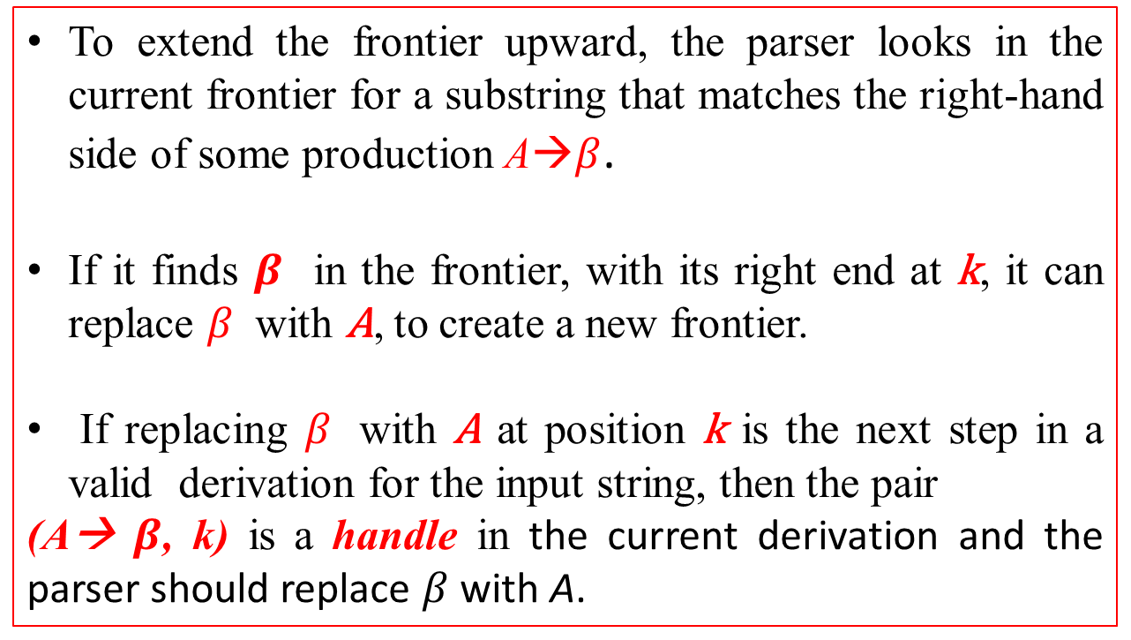
BOTTOM-UP PARSING
To extend the frontier upward, the parser looks in the current frontier for a substring that matches the right-hand side of some production A→$β$.
If it finds $β$ in the frontier, with its right end at k, it can replace $β$ with A, to create a new frontier.
If replacing $β$ with A at position k is the next step in a valid derivation for the input string, then the pair
(A→ $β$, k) is a handle in the current derivation and the parser should replace $β$ with A.

Slide 70
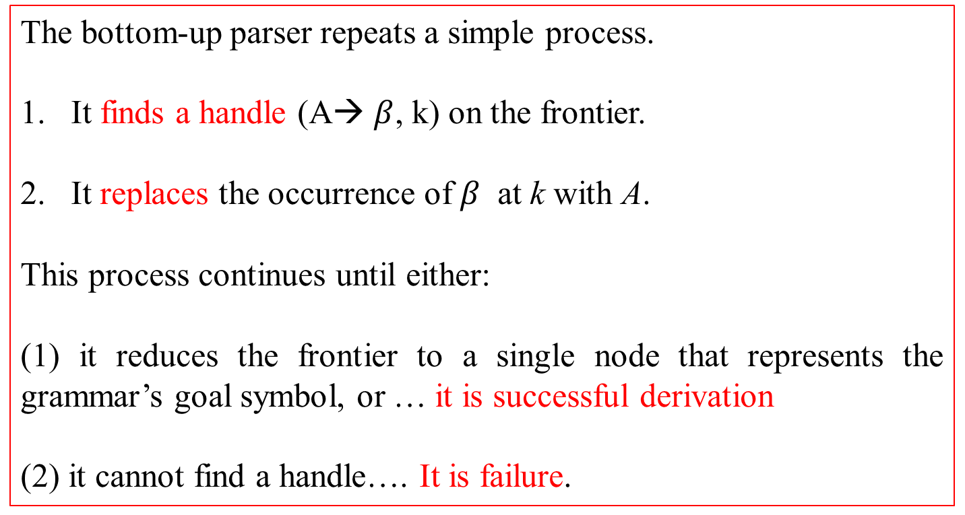
BOTTOM-UP PARSING
The bottom-up parser repeats a simple process.
It finds a handle (A→ $β$, k) on the frontier.
It replaces the occurrence of $β$ at k with A.
This process continues until either:
(1) it reduces the frontier to a single node that represents the grammar’s goal symbol, or … it is successful derivation
(2) it cannot find a handle…. It is failure.

Slide 71
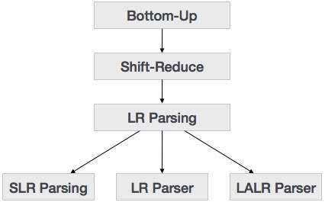
BOTTOM-UP PARSING

Slide 72
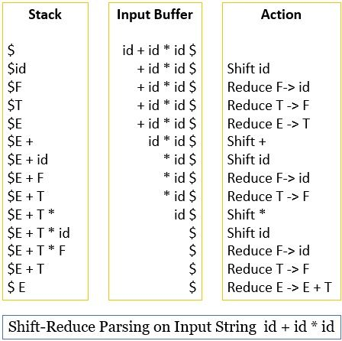
X + Y * Z

Slide 74
Recall
Top-down
For unambiguous grammars we can construct an efficient handle-finder, using a technique called LR parsing.
This section examines one particular flavor of LR parser, called a table-driven LR(1) parser.
"L" stands for left-to-right scanning of the input.
"R" stands for constructing a right most derivation in reverse.

Slide 75
The LR(1) Parsing Algorithm
An LR(1) parser scans the input from left to right to build a rightmost derivation in reverse.
At each step, it makes decisions based on the history of the parse and a lookahead of, at most, one symbol.
The name LR(1) derives from these properties:
Left-to-right scan,
Reverse rightmost derivation, and
1 symbol of lookahead.
A language has the LR(1) property if it can be parsed in a single left-to-right scan, to build a reverse-rightmost derivation, using only one symbol of lookahead to determine parsing actions.
The test to determine if a grammar has the LR(1) property is to let a parser generator attempt to build the LR(1) parser. If that process fails, the grammar lacks the LR(1) property.

Slide 76
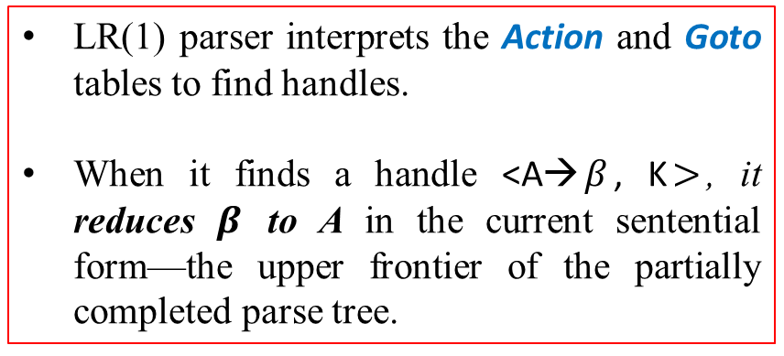
The LR(1) Parsing Algorithm
The critical step in a bottom-up parser is to find the next handle.
Efficient handle finding is the key to efficient bottom-up parsing.
The LR(1) parser uses a handle-finding automaton, encoded into two tables, called Action and Goto.
Figure 3.15 shows a simple table-driven LR(1) parser.
LR(1) parser interprets the Action and Goto tables to find handles.
When it finds a handle <A→$β$, K$>$, it reduces $β$ to A in the current sentential form—the upper frontier of the partially completed parse tree.

Slide 77
The LR(1) Parsing Algorithm
Rather than build an explicit parse tree, the skeleton parser keeps the current upper frontier of the partially constructed tree on a stack, interleaved with states from the handle-finding automaton that let it thread together the reductions into a parse.
At any point in the parse, the stack contains a prefix of the current frontier.
Beyond this prefix, the frontier consists of leaf nodes.
The variable word holds the first word in the suffix that lies beyond the stack’s contents; it is the lookahead symbol.

Slide 78
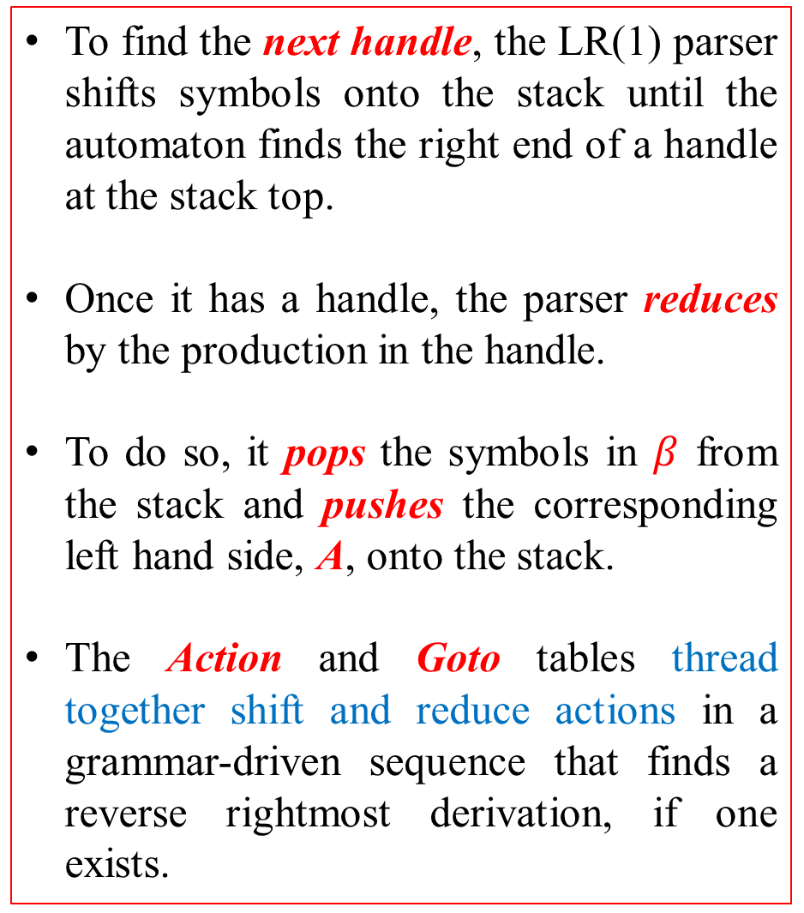
The LR(1) Parsing Algorithm
To find the next handle, the LR(1) parser shifts symbols onto the stack until the automaton finds the right end of a handle at the stack top.
Once it has a handle, the parser reduces by the production in the handle.
To do so, it pops the symbols in $β$ from the stack and pushes the corresponding left hand side, A, onto the stack.
The Action and Goto tables thread together shift and reduce actions in a grammar-driven sequence that finds a reverse rightmost derivation, if one exists.

Slide 79
The LR(1) Parsing Algorithm
An Example
Consider the grammar shown in Figure 3.16a, which describes the language of properly nested parentheses.
Figure 3.16b shows the Action and Goto tables for this grammar.
When used with the skeleton LR(1) parser, they create a parser for the parentheses language.
Consider the sequence of actions that LR(1) takes on the input string “( )”.

Slide 80
The LR(1) Parsing Algorithm
An Example
Input string “( )”

Slide 81
The LR(1) Parsing Algorithm
An Example
The first line shows the parser’s initial state.
Subsequent lines show its state at the start of the while loop, along with the action that it takes.
At the start of the first iteration, the stack does not contain a handle, so the parser shifts the lookahead symbol, (, onto the stack.
From the Action table, it knows to shift and move to state 3. At the start of the second iteration, the stack still does not contain a handle, so the parser shifts ) onto the stack to build more context. It moves to state 7.
In the third iteration, the stack contains a handle <pair→ ( ), t>, where t is the top of the stack.
After reduction, the parser moves to state 2 (specified by Goto[0,Pair]).
In fourth iteration the handle is <list→pair,t>, so reduction happens, and state changes to 1 (specified by Goto[0, list])
In fifth iteration, the 1.eof = ‘accept’

Slide 82
The LR(1) Parsing Algorithm
For the input string, “( ( ) ) ( ).”

Slide 83
Figure 3.18 shows the state of the partially-built parse tree at the start of each iteration of the parser’s while loop.
The top of each drawing shows an iteration number and a gray bar that contains the partial parse tree’s upper frontier.
In the LR(1) parser, this frontier appears on the stack.

Slide 84
The LR(1) Parsing Algorithm
An Example
Parsing an Erroneous Input String
To see how an LR(1) parser discovers a syntax error.
Input string “( ) )”

Slide 85
For the input string, “( ( ) ) ( ).”
Input string “( )”
Handle Finding
Between these two examples, the parser recognized the string ( ) at stack top as a handle three times.
It behaved differently in each case, based on the prior left context encoded in the stack.
The Action and Goto tables, along with the stack, cause the parser to track prior left context and let it take different actions based on that context

Slide 87
Building LR(1) Tables
To construct Action and Goto tables, an LR(1) parser generator builds a model of the handle-recognizing automaton and uses that model to fill in the tables.
The model, called the canonical collection of sets of LR(1) items, represents all of the possible states of the parser and the transitions between those states.
To illustrate the table-construction algorithm, we will use the parentheses grammar.
In an LR(1) parser, the Action and Goto tables encode information about the potential handles at each step in the parse.
The table-construction algorithm, therefore, needs a concrete representation for both handles and potential handles, and their associated lookahead symbols.
We represent each potential handle with an LR(1) item.

Slide 88
Building LR(1) Tables
The table-construction algorithm uses LR(1) items to build a model of the sets of valid states for the parser, the canonical collection of sets of LR(1) items.
The canonical collection CC = {CC0, CC1, CC2 … CCn}
The algorithm builds CC by following possible derivations in the grammar.
In the final collection, each set cci in CC contains the set of potential handles in some possible parser configuration.
Before we delve into the table construction, further explanation of LR(1) items is needed.

Slide 89
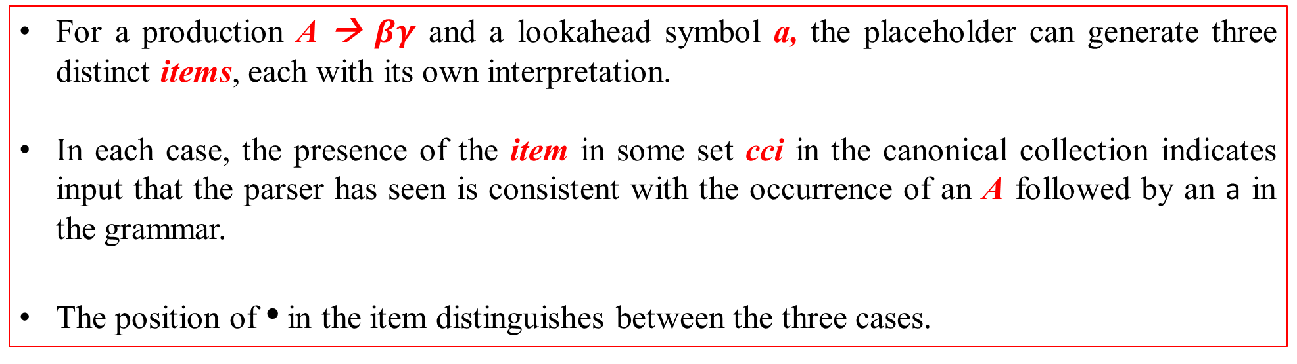
Building LR(1) Tables
For a production A → $βγ$ and a lookahead symbol a, the placeholder can generate three distinct items, each with its own interpretation.
In each case, the presence of the item in some set cci in the canonical collection indicates input that the parser has seen is consistent with the occurrence of an A followed by an a in the grammar.
The position of • in the item distinguishes between the three cases.

Slide 90
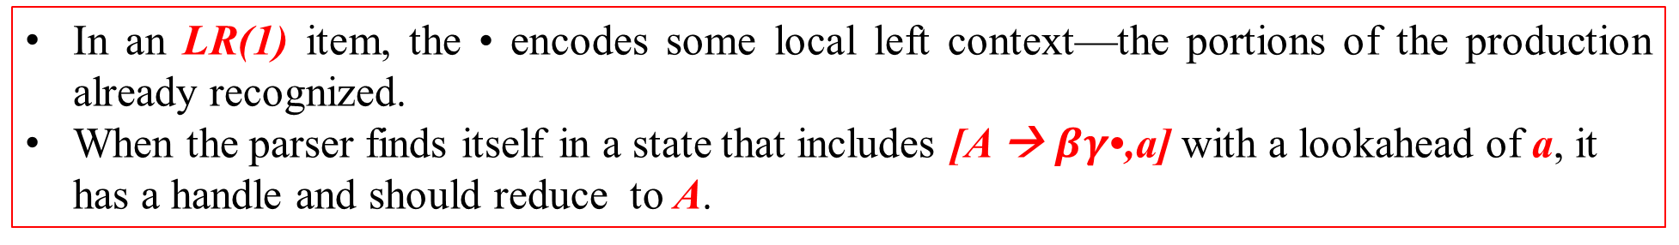
Building LR(1) Tables
In an LR(1) item, the • encodes some local left context—the portions of the production already recognized.
When the parser finds itself in a state that includes [A → $βγ$•,a] with a lookahead of a, it has a handle and should reduce to A.

Slide 92
Building LR(1) Tables
Complete set of LR(1) items generated by the parentheses grammar.
[Goal→ • List, eof],
Represents the initial state (labelled cc0) of the parser—looking for a string that reduces to Goal, followed by eof. Every parse begins in this state.
[Goal→ List •, eof],
Represents the desired final state of the parser—finding a string that reduces to Goal, followed by eof.
All of the possible parses starts from this first item and ends at the second item.

Slide 93
Constructing the Canonical Collection
To build the canonical collection of sets of LR(1) items, CC, a parser generator must start from the parser’s initial state, [Goal→ •List,eof], and construct a model of all the potential transitions that can occur.
The algorithm represents each possible configuration, or state, of the parser as a set of LR(1) items.
The algorithm relies on two fundamental operations on these sets of LR(1) items:
Taking a closure and
Computing a transition.

Slide 94
Constructing the Canonical Collection
The algorithm relies on two fundamental operations on these sets of LR(1) items: (1) Taking a closure and (2) Computing a transition.

Slide 95
Constructing the Canonical Collection
The closure Procedure
The item [Goal → • List, eof] represents the parser’s initial state for the parentheses grammar.
Every valid parse recognizes Goal followed by eof.
This item forms the core of the first state in CC, labelled cc0.
If the grammar has multiple productions for the goal symbol, each of them generates an item in the initial core of cc0.
To compute the complete initial state of the parser, cc0, from its core, the algorithm must add to the core all of the items implied by the items in the core.
The Closure procedure iterates over all the items in set s. If the placeholder • in an item immediately precedes some nonterminal C, then closure must add one or more items for each production that can derive C.
Closure places the • at the initial position of each item that it builds this way.

Slide 96
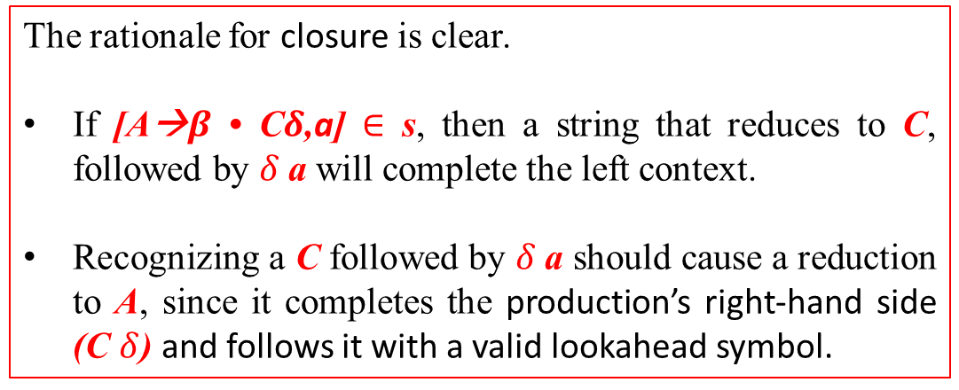
Constructing the Canonical Collection
The closure Procedure
The rationale for closure is clear.
If [A→$β$ • C$δ$,a] $∈$ s, then a string that reduces to C, followed by $δ$a will complete the left context.
Recognizing a C followed by $δ$a should cause a reduction to A, since it completes the production’s right-hand side (C $δ$) and follows it with a valid lookahead symbol.

Slide 97
Constructing the Canonical Collection
The closure Procedure

Slide 98
Constructing the Canonical Collection
The goto Procedure
The second fundamental operation that the construction uses is the goto function.
Goto takes as input a model of a parser state, represented as a set cci in the canonical collection, and a grammar symbol x.
It computes, from cci and x, a model of the parser state that would result from recognizing an x in state i.

Slide 99
Constructing the Canonical Collection
The goto Procedure
The goto function, shown in Figure 3.21, takes a set of LR(1) items s and a grammar symbol x and returns a new set of LR(1) items.
It iterates over the items in s.
When it finds an item in which the immediately precedes x, it creates a new item by moving the rightward past x.
This new item represents the parser’s configuration after recognizing x.
Goto places these new items in a new set, takes its closure to complete the parser state, and returns that new state.

Slide 100
Constructing the Canonical Collection
The goto Procedure
Given the initial set for the parentheses grammar,
we can derive the state of the parser after it recognizes an initial “(“ by computing goto(cc0, “(“ ).
It returns…
The inner loop finds four items that have • before “(“.
Goto creates a new item for each, with the • advanced beyond “(“.
Closure adds two more items, generated from the items with • before Pair.
These items introduce the lookahead symbol “)”.
Thus, goto(cc0,( ) returns above result.

Slide 101
Constructing the Canonical Collection
The goto Procedure
To find the set of states that derive directly from some state such as cc0, the algorithm can compute goto(cc0,x) for each x that occurs after a • in an item in cc0.
This produces all the sets that are one symbol away from cc0.
To compute the complete canonical collection, we simply iterate this process to a fixed point.

Slide 102
Constructing the Canonical Collection
The goto Procedure

